Slide 1



NeuroFleetX – AI-Driven Urban Mobility
Team Members
Kumar Sarish
M. Jayanth
G.Suma Likhitha
Anurag Tiwari
Aman Gupta
Next-Gen Smart Fleet & Rental Transport Solution for Urban Mobility

Slide 2



Introduction
Infosys springboard
NeuroFleetX is a next-generation AI-driven platform that transforms urban mobility and fleet operations.
It integrates AI, IoT, and geospatial data to provide real-time vehicle tracking and predictive route planning.
The platform enhances fleet rental services, improves decision-making, and promotes sustainable transportation.
Designed for scalability with mobile-first enterprise features for fleet managers and customers.
TEAM-A
02

Slide 3


Problem Statement
Infosys springboard
Current urban mobility systems are reactive, inefficient, and fragmented.
Lack of real-time tracking leads to delays, wasted fuel, and poor resource utilization.
Fleet managers face challenges in maintenance prediction, route optimization, and data insights
There is a need for a unified, intelligent, AI-powered platform to manage and optimize mobility operations.
TEAM-A
05

Slide 4

Objectives
Infosys springboard
Develop a smart, AI-based fleet management system
Implement real-time telemetry for vehicle tracking using IoT and geolocation
Enable predictive route planning and maintenance forecasting using machine learning.
Build an intuitive frontend for customers, admins, and fleet operators.
Support sustainability goals through efficient route planning and reduced emissions.
TEAM-A
06

Slide 5

Technologies Used
Infosys springboard
Frontend
React.js (Dynamic dashboards, Google Maps API integration)
Backend
Spring Boot 6.0 (Java 21) – RESTful APIs & real-time WebSockets
Data base
Firebase Firestore (NoSQL cloud database)
AI Engine
Python (Machine learning models for traffic and route prediction)
Authentication
Firebase Authentication (Role-based access control)
Integration
Google Maps API, WebSocket communication for live updates
TEAM-A
07

Slide 6





System Architecture
Infosys springboard
Sierrawood School
Frontend (React)
Backend (Spring Boot)
Database (Firebase Firestore)
AI Micro service Python
User interface for admin, manager, and customer portals.
Predictive model for maintenance and route optimization.
REST APIs, WebSocket for live telemetry.
Stores vehicle, user, and booking data.
Social Science Class
08

Slide 7

Infosys springboard
Telemetry Module
Real-time vehicle tracking using Spring Boot WebSockets.
Inventory Management
Work Done!
CRUD operations for vehicles and fleet details.
Customer Booking System
Smart booking with vehicle recommendations.
Modules Implemented
Role-Based Access Control
Admin and user access through Firebase Auth.
Predictive Maintenance
ML-based insights for vehicle health monitoring.
Dashboard
Real-time analytics and operational overview for fleet managers.
TEAM-A
09

Slide 8
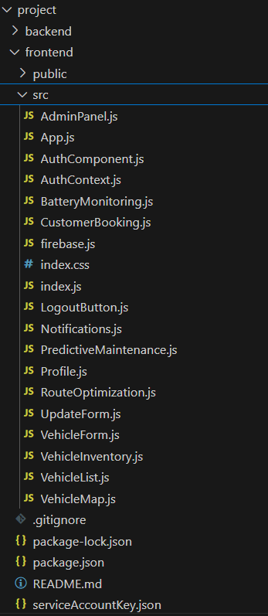
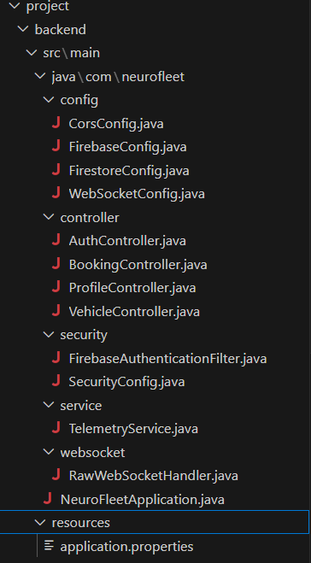
Frontend
Backend
Infosys springboard
Filesystem
structure
TEAM-A
09

Slide 9
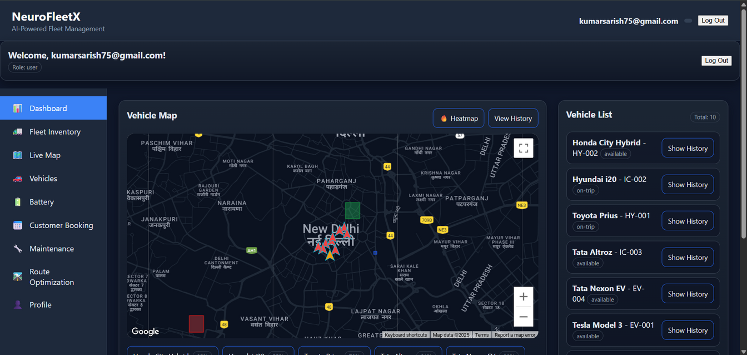
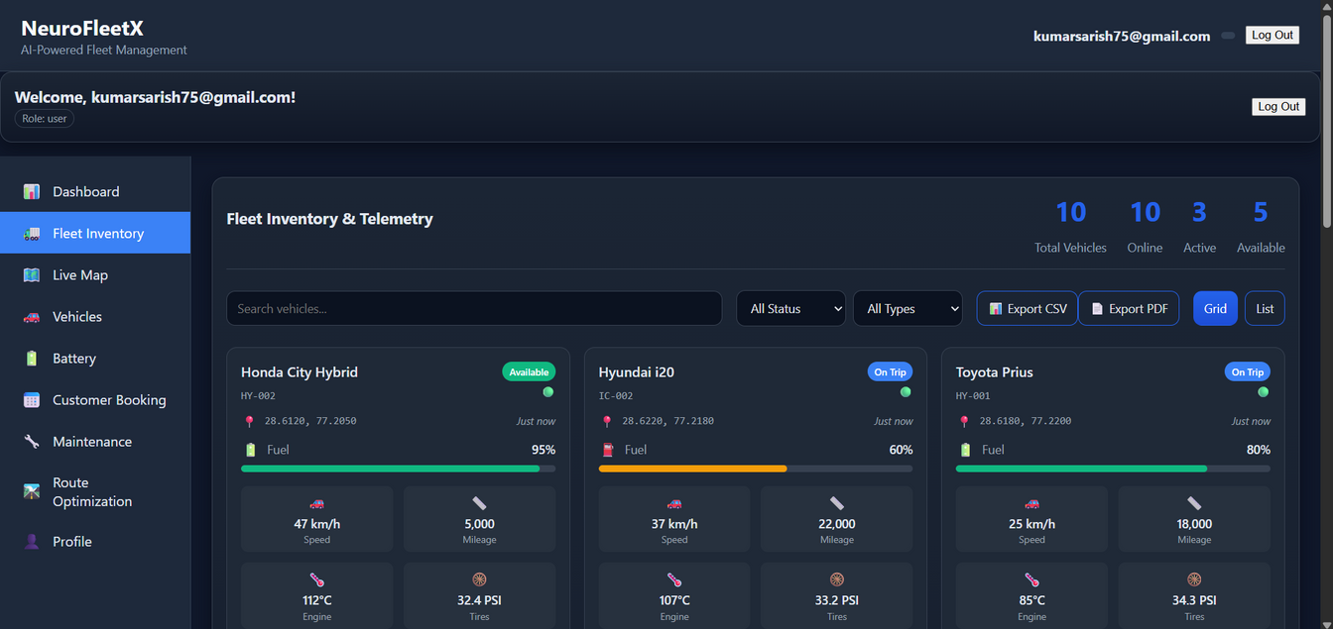
Infosys springboard
Dashboard
Fleet Inventory
TEAM-A
10

Slide 10
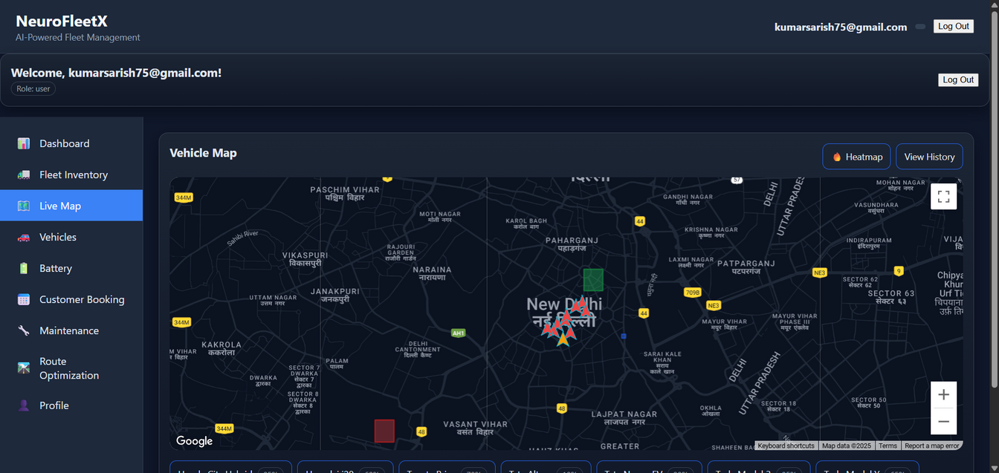
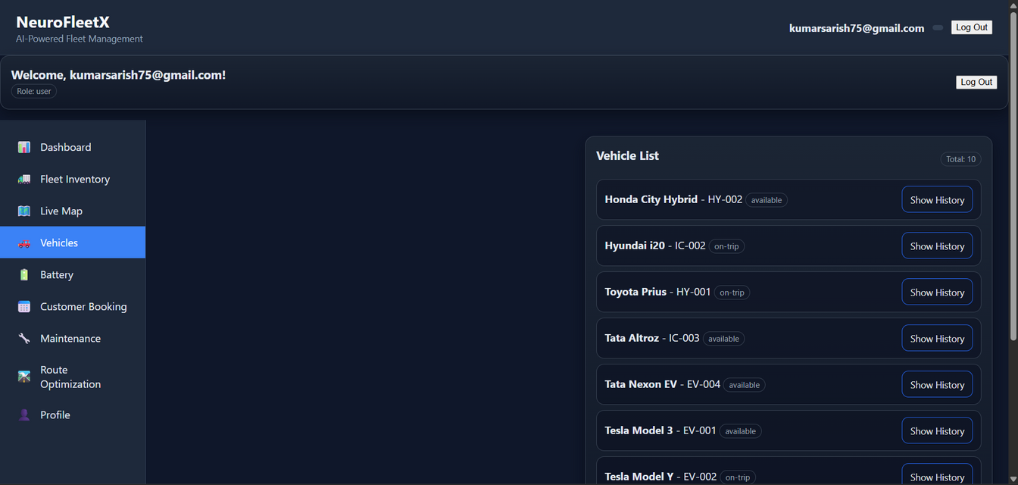
Infosys springboard
Live map
vehicles
TEAM-A
11

Slide 11
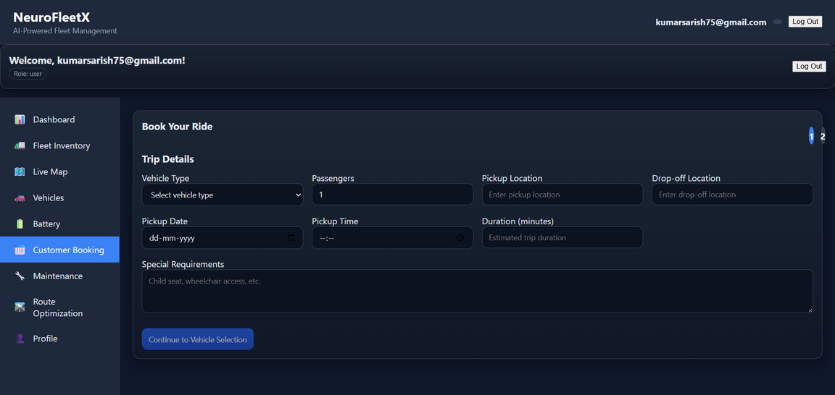
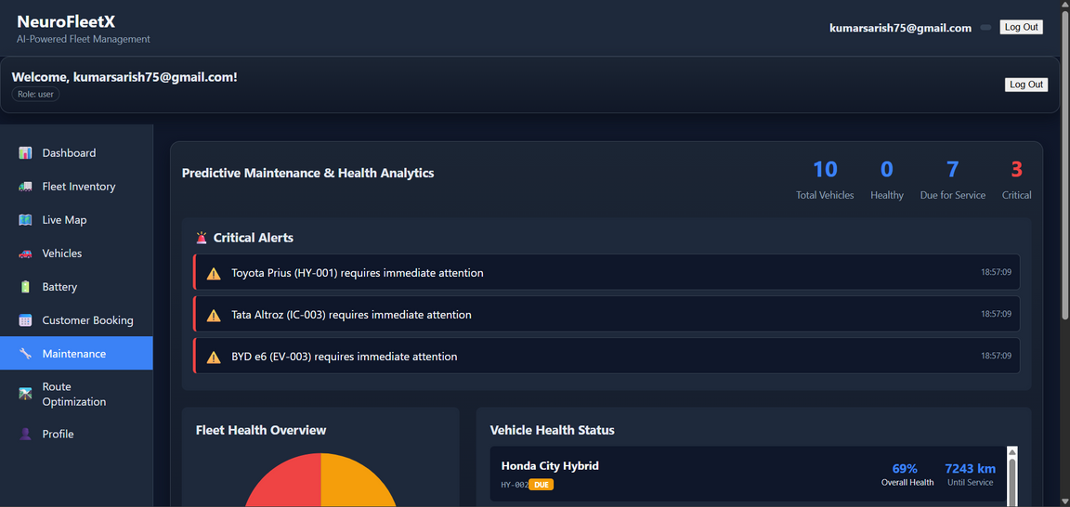
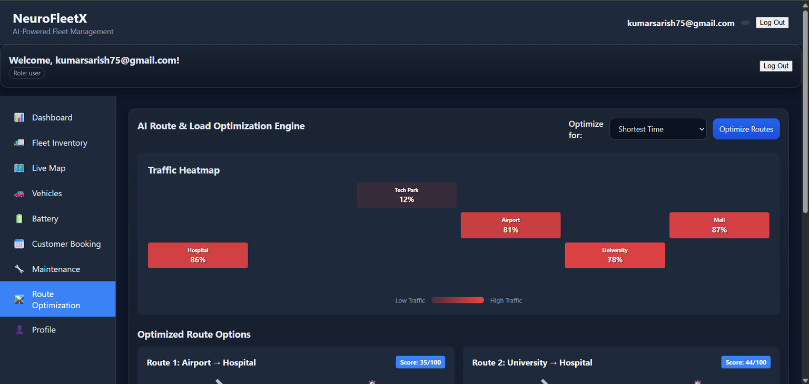
Infosys springboard
TEAM-A
11

Slide 12
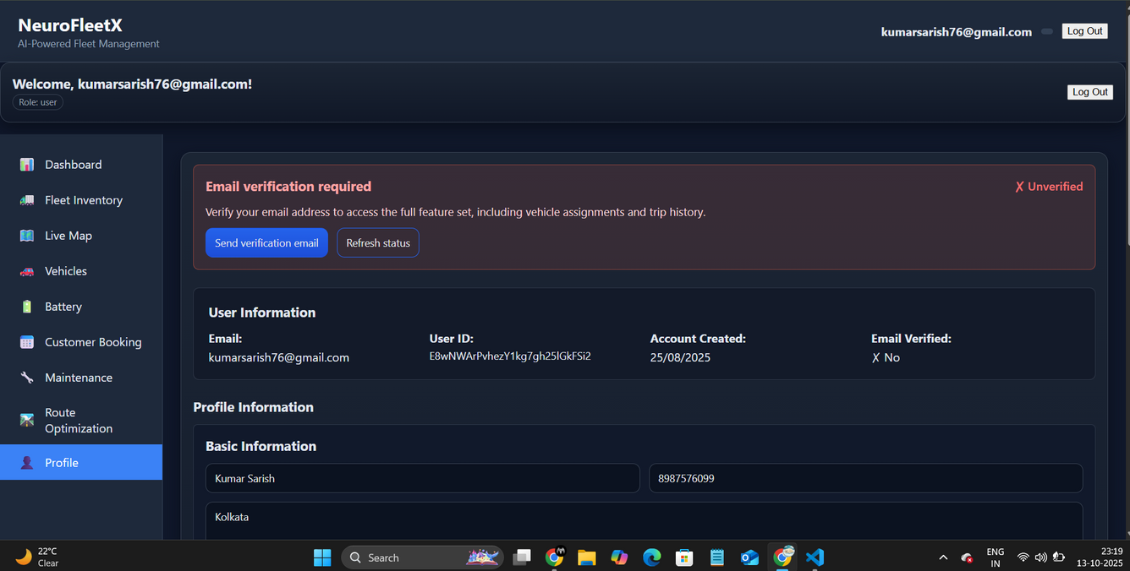
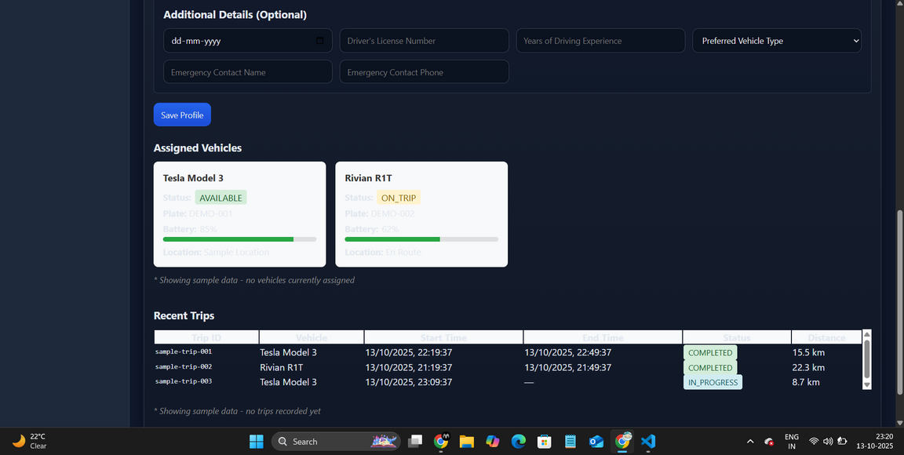
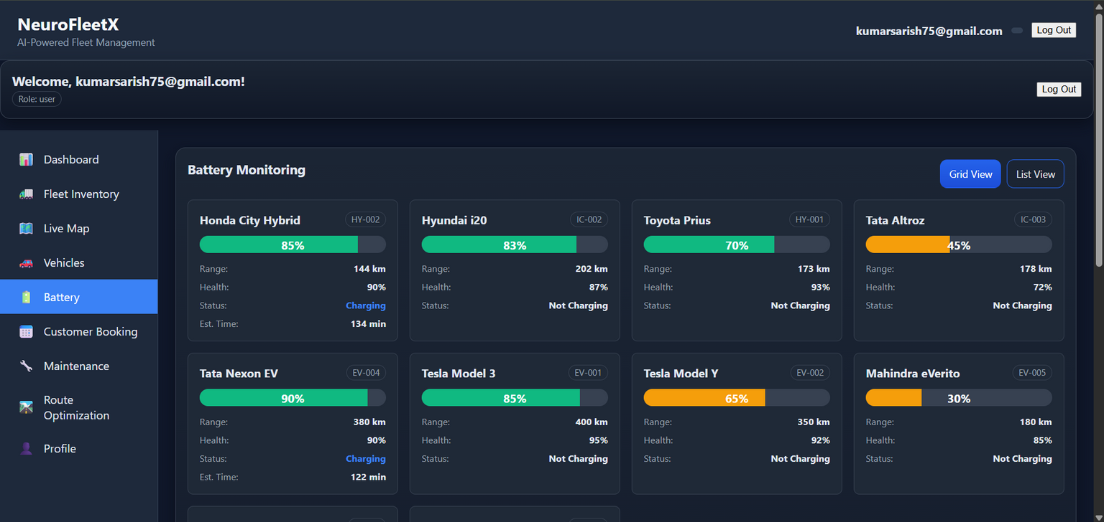
Infosys springboard
TEAM-A
11

Slide 13

Advantages
Infosys springboard
Real-time visibility:
Predictive intelligence:
Live location tracking and performance insights
AI models prevent downtime and delays
Optimized operations:
Cloud-based scalability:
Reduces cost, time, and fuel consumption.
Reliable and modular microservice design.
Enables smart route planning for eco-efficiency
TEAM-A
17

Slide 14
Infosys springboard
Future Enhancements
EV Fleet Integration
Driver Behavior Analysis
AI Traffic Prediction
Optimize routes for electric vehicles.
City-level traffic forecasting and congestion control.
Monitor and improve driving performance.
Blockchain Security
Mobile Application
TEAM-A
Secure booking, transactions, and fleet records.
Android/iOS app for drivers and customers.
13

Slide 15

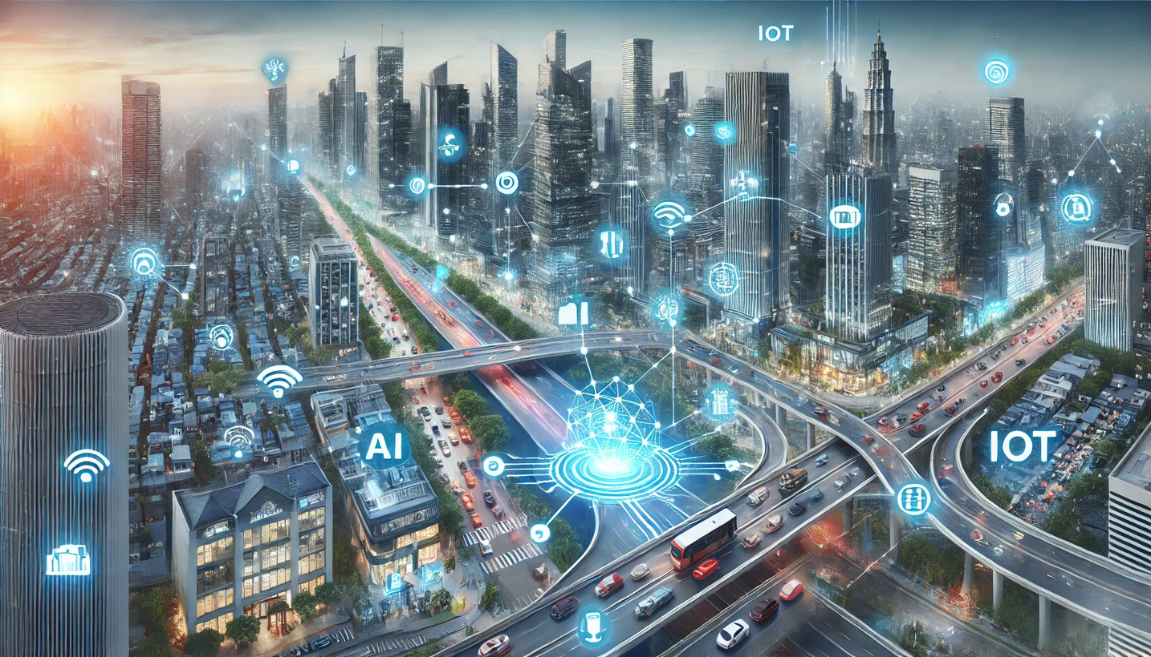
Infosys springboard
Conclusion
NeuroFleetX revolutionizes fleet management with AI, IoT, and predictive analytics.Provides real-time visibility, automated decisions, and operational efficiency.
Supports smart city development and sustainable mobility goals.
TEAM-A
15

Slide 16
Infosys springboard
THANK YOU
TEAM-A
12

